Slide 1
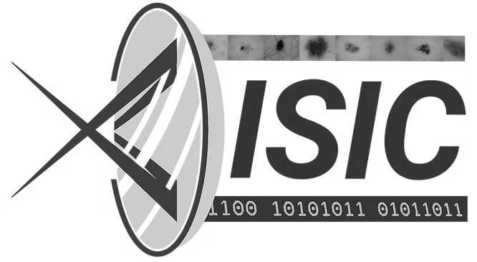
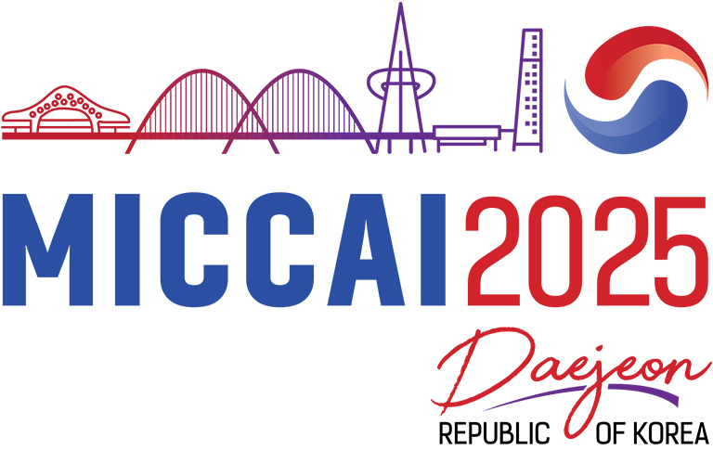

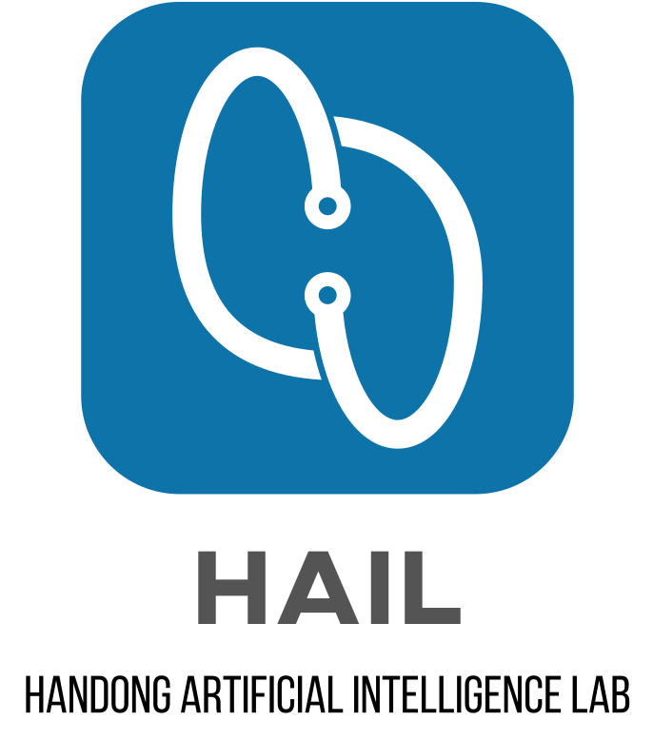
10th International Skin Imaging Collaboration (ISIC) Workshop on Skin Image Analysis @ MICCAI 2025
Retrieval-Augmented VLMs for Multimodal Melanoma Diagnosis
Jihyun Moon , Charmgil Hong
{jhmoon, charmgil}@handong.ac.kr
Handong Global University
Notes:
Hello, everyone.
My name is Jihyun Moon, a Master’s student at Handong Graduate School.
I conducted this research under the Professor Charmgil Hong, and I’m excited to share our findings today.
Today, I am here to present "Retrieval-Augmented VLMs for Multimodal Melanoma Diagnosis."

Slide 2

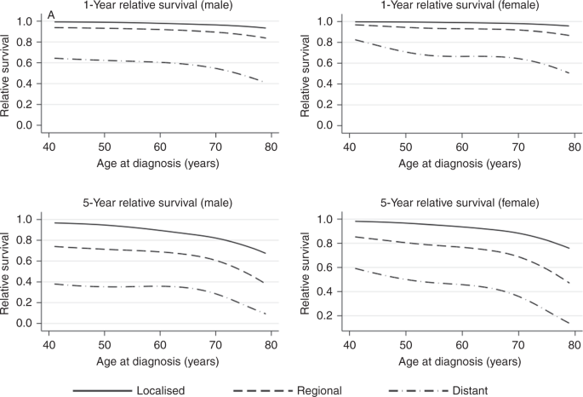
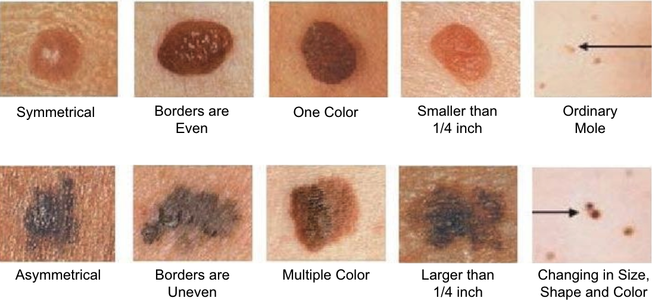
Background
Malignant Melanoma
Early Detection Critical
99% vs < 35% survival rate
Traditional Approach: ABCDE rule
Clinical expertise: Pattern recognition based on experience
AI-based Diagnostic Tools
Single Modality
Image-only methods
Limited to visual features, require preprocessing
Multi-Modality
Vision-Language Models (VLMs): Join processing of images and text
Advantages: No preprocessing required, integrate clinical information
Challenge: General-purpose training
Male
Female
A
Asymmetry
B
Border
C
Color
D
Diameter
E
Evolving
1-Year relative survival
Normal
5-Year relative survival
Melanoma
1- and 5-year relative survival curves as a function of age at diagnosis ^{[Aiden et al., 2020]}
The ABCDEs of Detection Melanoma ^{[Alfghani, 2018]}
Notes:
Let me begin the critical importance of our research focus - malignant melanoma.
Early detection is absolutely crucial in melanoma diagnosis. The statistics speak: when detected early, the survival rate is 99%. However, if detection is delayed, rate decrease less than 35%. This dramatic difference underscores why improving diagnostic accuracy is critical.
Traditionally, clinicians have relied on the ABCDE rule for melanoma detection. This approach depends heavily on clinical expertise and pattern recognition based on years of experience. While effective, it's inherently subjective and can vary between practitioners.
This brings us to AI-based diagnostic tools, which fall into two main categories. First, we have single modality approaches - primarily image-only methods. While these have shown promise, they're limited to visual features alone and typically require extensive preprocessing steps.
More recently, we've seen the emergence of multi-modality approaches, particularly Vision-Language Models, VLMs. These models can jointly process both images and text, offering significant advantages: they eliminate the need for preprocessing and can integrate clinical information alongside visual data.
However, there's a key challenge - most VLMs are trained for general purposes, not specifically for medical diagnosis.

Slide 3
Challenges
VLMs for Medical Domain
General-purpose training: Lack medical domain specificity
Fine-tuning limitation: Resource intensive, privacy constraints, data variability
Example-based explainability - Find similar cases to justify decision
More effective at decisions if they mimicked a dermatologist’s experience
AI: Classification based on content-based image retrieval
Human: Compare with similar cases with structured analysis
Notes:
Now, let's dive into the specific challenges we face when applying VLMs to the medical domain.
The first major issue is that existing VLMs are trained for general purposes, which means they lack the medical domain specificity that's crucial for accurate diagnosis.
While fine-tuning seems like an obvious solution, it comes with significant limitations:
it's extremely resource-intensive, raises privacy constraints when dealing with sensitive medical data, and struggles with the inherent variability in medical datasets.
This led us to explore a different approach - example-based explainability.
The core idea is to find similar cases that can justify diagnostic decisions, much like how experienced dermatologists actually work.
Think about how this mimics real clinical practice.
When we look at current AI systems, they essentially function as black boxes - they provide classifications without any reasoning context.
A doctor receives a diagnosis but has no insight into why the AI made that decision.
In contrast, human dermatologists naturally compare new cases with similar ones they've encountered before, conducting structured analysis based on their experience.
They might think, 'This lesion reminds me of a case I saw last month that turned out to be malignant because of these specific features.'
Our goal is to bridge this gap - creating AI that not only provides accurate diagnoses but also explains its reasoning in a way that mirrors how dermatologists actually think.

Slide 4
Motivation
Retrieval-Augmented Generation (RAG) for Medical Reasoning
Clinical insight: Physicians compare new cases with similar historical cases
External knowledge: Incorporates relevant examples without fine-tuning
Medical application: Retrieve similar patient cases
Retrieval-augmented VLM-based diagnostic framework
Can VLM be effectively used for dermoscopic image classification?
Does RAG improve performance through example-based reasoning without fine-tuning?
Notes:
This brings us to our core approach: Retrieval-Augmented Generation, RAG, specifically designed for medical reasoning.
The key advantage of RAG is that it aligns with clinical practice.
Physicians naturally compare new cases with similar historical cases they've encountered.
RAG systematizes this approach by incorporating external knowledge - specifically, relevant examples from a database - without requiring the resource-intensive fine-tuning.
In our medical application, this means we can retrieve similar patient cases that share characteristics with the current case under examination.
The system can then use these retrieved examples to inform its diagnostic reasoning, much like a dermatologist drawing upon their experience.
This led us to develop a retrieval-augmented VLM-based diagnostic framework, which brings us to our two key research questions:
First: Can Vision-Language Models be effectively used for dermoscopic image classification?
We wanted to establish whether VLMs, originally designed for general tasks, could handle the specialized requirements of medical image analysis.
Second, and perhaps more importantly: Does RAG actually improve diagnostic performance through example-based reasoning, and can it do so without the need for fine-tuning?
This explores whether example-based reasoning can enhance diagnostic accuracy without the need for fine-tuning.
Our experimental design was structured around these two questions, which I'll now present.

Slide 5
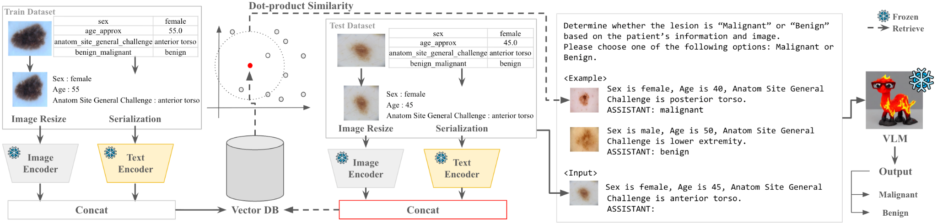
Proposed Approach
Multimodal Embedding and Case Indexing (Indexing)
Semantically-Guided Retrieval (Retrieval)
Prompt Construction and VLM Inference (Generation)
Notes:
To address these research questions, we developed our proposed framework.
Our approach is a multimodal diagnostic framework that combines a Vision-Language Model with Retrieval-Augmented Generation to classify melanoma using both dermoscopic images and clinical metadata.
The framework is built on the observation that in clinical practice, diagnosis often involves comparing a current case with prior cases that share similar visual features or clinical attributes.
This example-based reasoning approach improves diagnostic accuracy by leveraging past experience.
Here's how our system works: we incorporate a retrieval module that searches a database of dermoscopic images and metadata to find semantically similar cases.
These retrieved examples serve as clinical references, providing contextual support for the model's prediction.
The key innovation is in how we integrate these retrieved cases.
We embed them directly into the VLM input prompt, allowing the system to perform comparative reasoning similar to human diagnosis.
As you can see in this architectural overview, the framework integrates the retrieval component with the VLM to create a more clinically-relevant diagnostic system.

Slide 6
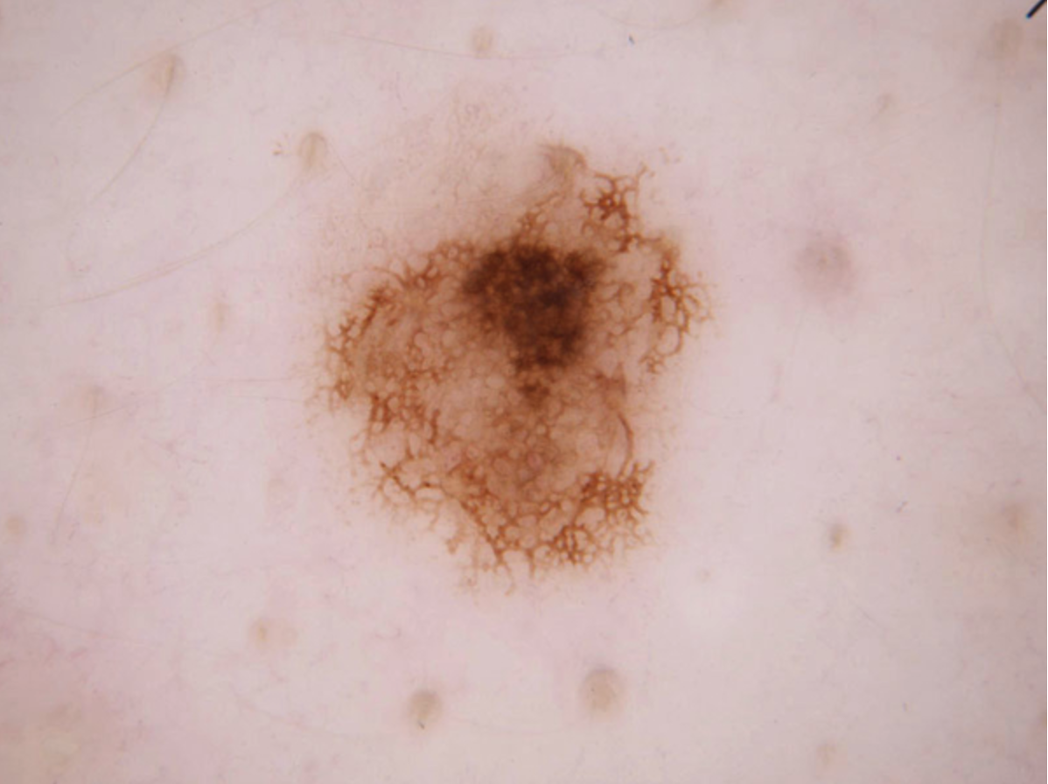
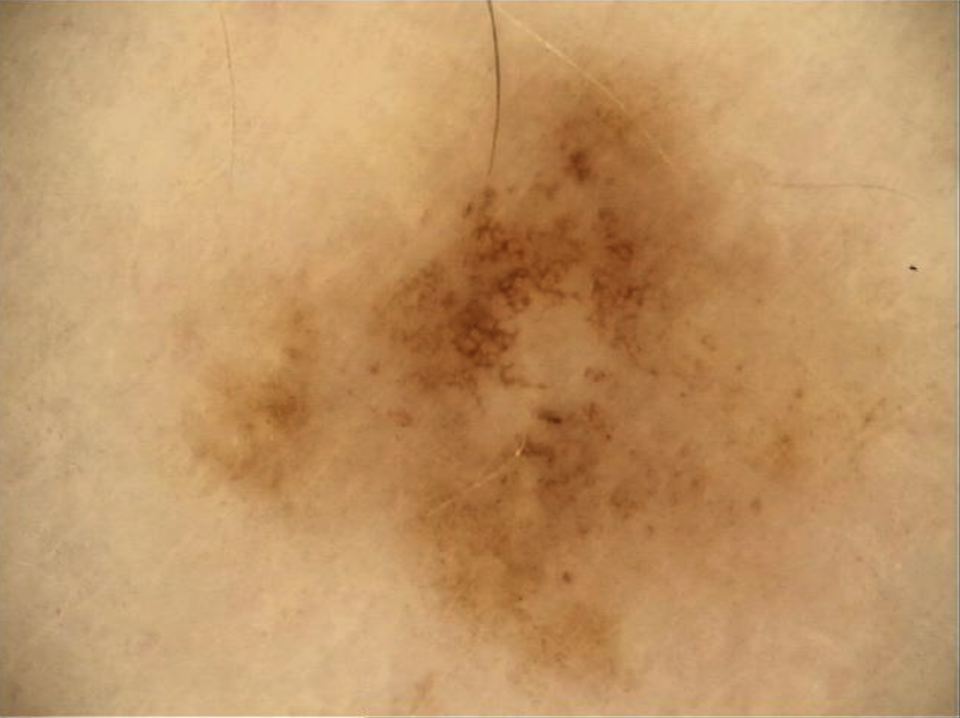
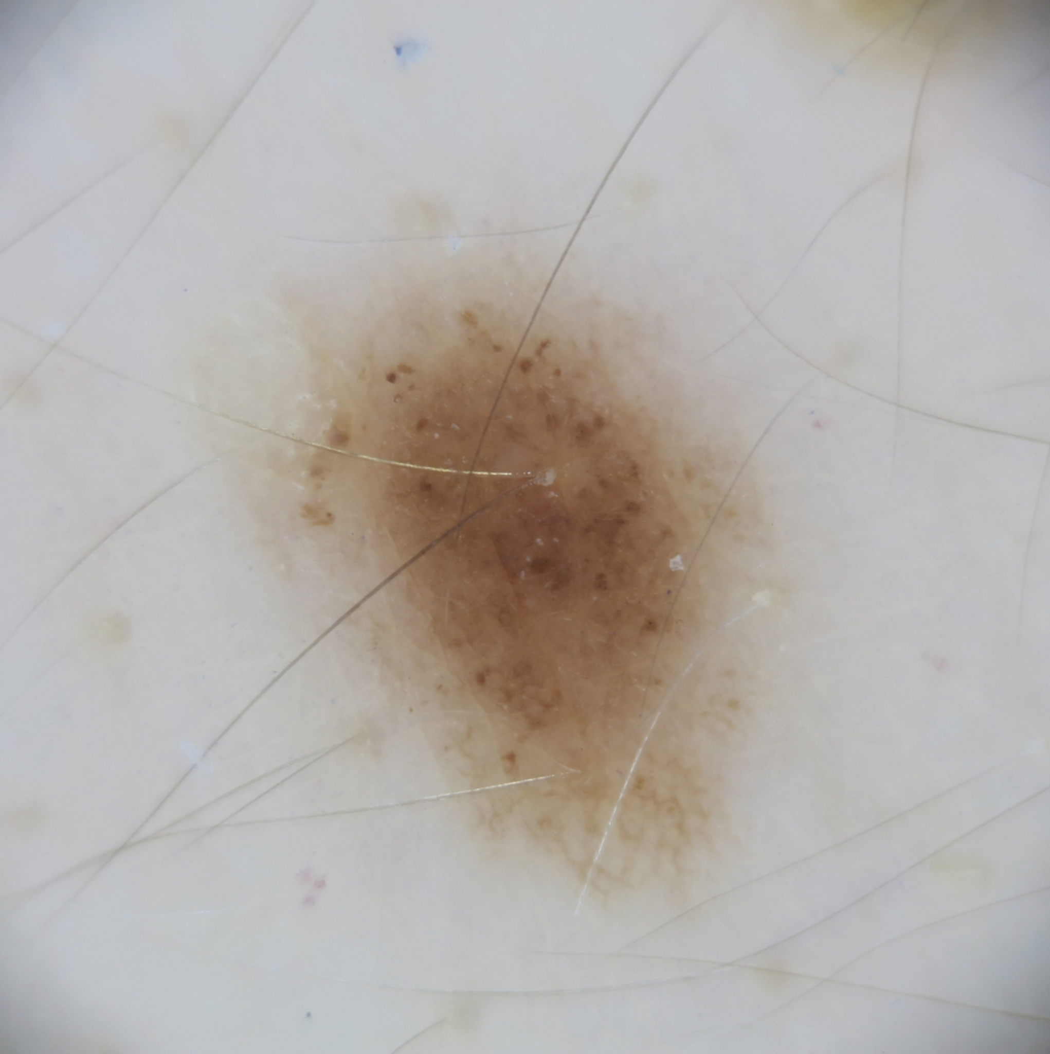
Proposed Approach
Prompt Construction
Task Definition
Clear instruction to classify
Determine whether the lesion is “Malignant” or “Benign” based on the patient’s information and image.
Please choose one of the following options: Malignant or Benign.
<Example>
Sex is female, Age is 40, Anatom Site General Challenge is posterior torso. ASSISTANT: malignant
Sex is male, Age is 50, Anatom Site General Challenge is lower extremity. ASSISTANT: benign
<Input> Sex is female, Age is 45, Anatom Site General Challenge is anterior torso. ASSISTANT:
Constrained Output
Contextual Examples
Infer the label
Top-K (K-shot) similar cases
Target query
Zero-shot cases
Notes:
Now, here's where things get interesting - we have the flexibility to use VLMs in creative ways!
Unlike traditional machine learning approaches that require extensive training, we can simply talk to our VLM through carefully constructed prompts.
This gives us remarkable freedom in how we approach the problem.
Our prompt construction follows a structured approach with several key components.
First, we provide a clear task definition - explicit instructions to classify the dermoscopic images as either benign or malignant.
We also constrain the output format to ensure consistent, parseable responses.
Here's where the RAG component comes in: we include contextual examples in our prompt.
These are the top-K most similar cases we retrieved from our database - essentially K-shot learning where the model can infer the correct label by examining these reference cases.
Finally, we present the target query - the new case we want to classify.
This becomes a zero-shot scenario for the specific case.
This approach is its simplicity and interpretability.
We're essentially having a conversation with the model: 'Here are some similar cases and their diagnoses. Now, what do you think about this new case?'

Slide 7
Proposed Approach
Template-Based Sentence Transformation
3 serialization strategies:
HTML: Preserve tabular structure
Attribute-Value pair: Reduce prompt length and improve parsing
Sentence: VLMs training style
Sex is female, Age is 55, Anatomic Site General Challenge is anterior torso.
<table> <tr> <th>Sex</th> <th>Age</th> <th>Anatomic Site General Challenge</th> </tr> <tr> <td>female</td> <td>55</td> <td>anterior torso</td> </tr> </table>
Sex: female, Age: 55, Anatomic Site General Challenge: anterior torso
Attribute | Value
sex | female
age_approx | 55.0
anatomic_site_general_challenge | anterior torso
benign_malignant | benign
Raw Clinical Metadata
HTML
Attribute-Value Pair
Sentence
Notes:
Now, let's talk about how we handle the clinical metadata in our prompts.
We use template-based sentence transformation to convert structured clinical data into text that VLM can effectively process.
We explored three different serialization strategies, each with its own advantages.
First is the HTML format, which preserves the original tabular structure of the clinical data.
Second, we have the Attribute-Value pair format.
This approach reduces prompt length significantly and improves parsing efficiency by presenting the information in a more compact form.
Third is the Sentence format, which aligns with how VLMs were originally trained.
This converts the structured data into natural language sentences, making it more compatible with the model's training paradigm.
Each strategy represents a different trade-off between information preservation, computational efficiency, and model compatibility.
We tested all three to determine which approach works better for our melanoma classification task.

Slide 8
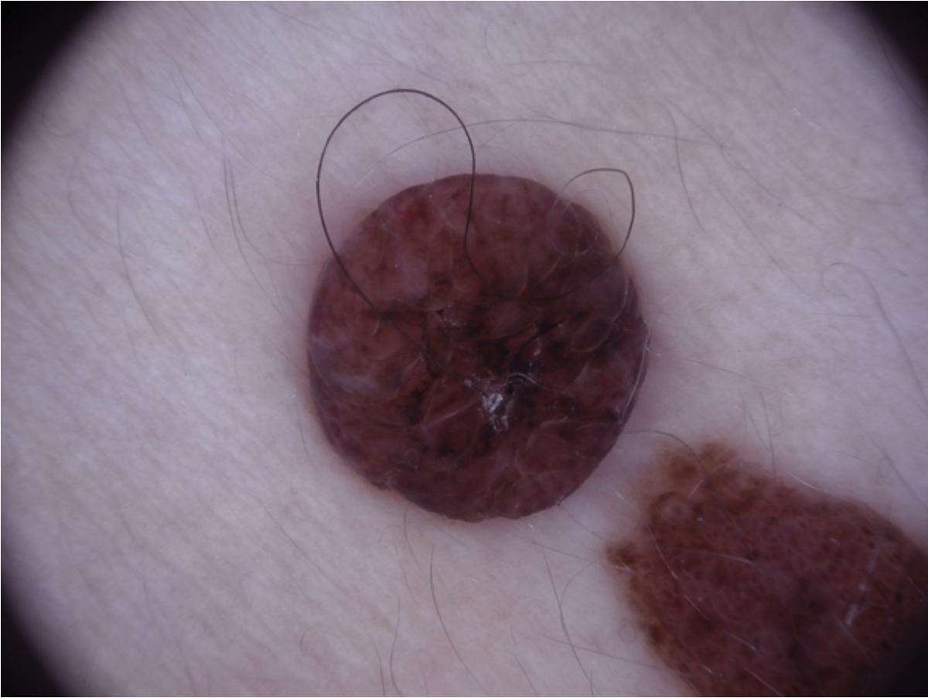

Proposed Approach
Multimodal Embedding and Case Indexing
Use modality-specific encoders
Image: Resized to 224x224 and encoded using CNN backbones
ResNeXt-50, EfficientNet-V2-M
Text: Serialized into text and embedding using a pre-trained language model
CNN backbones
Image Embedding
Resize (224x224)
Attribute | Value
sex | female
age_approx | 55.0
anatomic_site_general_challenge | anterior torso
benign_malignant | benign
Sex is female,
Age is 55,
Anatomic Site General Challenge is anterior torso.
BERT
Text Embedding
Notes:
Now let's move to the retrieval component of our framework - multimodal embedding and case indexing.
To effectively retrieve similar cases, we need to represent both images and clinical metadata in a unified embedding space.
We use modality-specific encoders to handle each data type appropriately.
For images, we resize dermoscopic images to 224x224 pixels and encode them using CNN backbones.
Specifically, we experimented with ResNeXt-50 and EfficientNet-V2-M architectures to capture visual features.
For text data, we serialize the clinical metadata into text format using one of the transformation strategies I just presented, then create embeddings using BERT, a pre-trained language model.
This approach allows us to create meaningful representations of both visual and textual information, which we can then use to identify cases that are similar across both modalities - matching not just visual appearance, but also clinical characteristics.

Slide 9

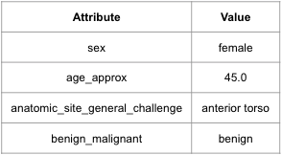
Proposed Approach
Case Indexing and Retrieval
Stored in FAISS-based database
Similarity is computed using dot-product
Top-K (K-shot) most similar patient cases retrieved as contextual examples
Image Embedding
Concat
Image
Text
Text Embedding
Vector Database
Image
Text
User
Notes:
Once we have our multimodal embeddings, we need to store and retrieve similar cases.
We store all case embeddings in a FAISS-based database.
When a new case comes in, similarity is computed using dot-product between the query embedding and all stored case embeddings.
This gives us a similarity score for every case in our database.
Finally, we retrieve the top-K most similar patient cases to serve as contextual examples in our VLM prompt.
These K cases become K-shot examples that help inform the model's decision on the new case.
This retrieval process is allowing us to identify the most relevant historical cases that share similar characteristics with the current diagnosis target.

Slide 10

Proposed Approach
Classification using VLMs
Generate diagnosis results in natural language text form
Parse to extract sentence containing the keywords “malignant” or “benign”
Determine whether the lesion is “Malignant” or “Benign” based on the patient’s information and image.
Please choose one of the following options: Malignant or Benign.
<Example>
Sex is female, Age is 40, Anatom Site General Challenge is posterior torso. ASSISTANT: malignant
Sex is male, Age is 50, Anatom Site General Challenge is lower extremity. ASSISTANT: benign
<Input> Sex is female, Age is 45, Anatom Site General Challenge is anterior torso. ASSISTANT:
Generate
LLaVA
The lesion appears to be malignant
Parse
Malignant
Malignant
Benign
Benign
This lesion is benign.
Notes:
So how do we actually get diagnostic results from our VLM?
First, we generate diagnosis results in natural language text form - the VLM responds just like a dermatologist would, providing conclusions in English.
Then comes the parsing step.
We extract the sentence containing the key diagnostic keywords - either "malignant" or "benign."
This is where the constrained output format I mentioned earlier becomes crucial - it ensures we can reliably identify the model's final classification.
Finally, we determine the diagnosis based on the extracted keywords, converting the natural language response into a structured diagnostic output.
This approach allows us to work with VLMs in their native format while still obtaining the binary classification we need for evaluation.

Slide 11
Experimental Setup
ISIC 2019 dataset
Binary classification task: Malignant vs. Benign
Dermoscopic images with corresponding patient metadata (age, sex, anatomical site)
70/30 split for train / test
Evaluation metrics
Accuracy, Balanced accuracy, F1 score
Baselines
Image-based: ResNeXt-50, EfficientNet-V2-M
Text-based: Random Forest, Vicuna-7B v1.5
Multimodal early-fusion: Classified via Random Forest, ReLU-activated FNN
Zero-shot VLM: LLaVA v1.5
Ours
Training data (16,756 image–text pairs) indexed with FAISS
Retrieve Top-2 neighbors (K = 1,2,3,4)
Notes:
For our experimental evaluation, we used the ISIC 2019 dataset for binary classification - distinguishing between malignant and benign cases.
The dataset includes dermoscopic images with corresponding patient metadata such as age, sex, and anatomical site.
We used a standard 70/30 split for training and testing.
We evaluated performance using accuracy, balanced accuracy, and F1 score.
Given the inherent class imbalance in medical datasets, F1 score is particularly important as it provides a comprehensive assessment that accounts for both precision and recall.
We compared our approach against five baseline approaches across different modalities.
For image-based methods, we tested ResNeXt-50 and EfficientNet-V2-M.
Text-based baselines included Random Forest and Vicuna-7B v1.5.
We also implemented multimodal early-fusion approaches using Random Forest and ReLU-activated feedforward neural networks.
As a direct comparison to our RAG-enhanced approach, we tested zero-shot VLM performance using LLaVA v1.5 without any retrieval component.
For our method, we indexed the training data - 16,756 image-text pairs - using FAISS, and retrieved the top-K neighbors for each test case.
Through experimentation, we found that K equals 2 provided the optimal balance between context and computational efficiency.

Slide 12
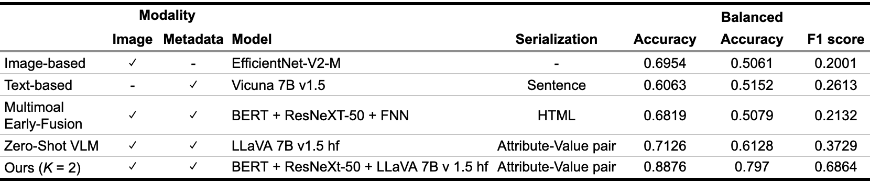
Results
Can VLM be effectively used for dermoscopic image classification?
Single-Modality Limitations: Image-based and text-based achieve < 30% F1 score
Multimodal advantage: 42.7% improvement
VLM advantage: 74.9% improvement
RAG effectiveness:
Achieve 44% improvement over best baseline
1.8x better than zero-shot VLM
Baselines
+ 42.7%
+ 74.9%
+ 44%
Notes:
Our results address the first research question: Can VLMs be effectively used for dermoscopic image classification?
The answer can be yes, but with important considerations.
Single-modality approaches showed significant limitations - both image-based and text-based methods achieved less than 30% F1 score, indicating that relying on just one type of information is insufficient for accurate melanoma diagnosis.
However, we see an improvement when we move to multimodal approaches.
Early-fusion methods demonstrated an 82% improvement over single-modality baselines, confirming that combining visual and clinical information is crucial.
Most importantly, our RAG-enhanced approach proved highly effective.
We achieved a 44% improvement over the best baseline method, and performed 1.8 times better than zero-shot VLM without retrieval.
These results demonstrate that VLMs can indeed be effectively used for dermoscopic image classification, but their performance is significantly enhanced when combined with retrieval-augmented generation and multimodal information.

Slide 13
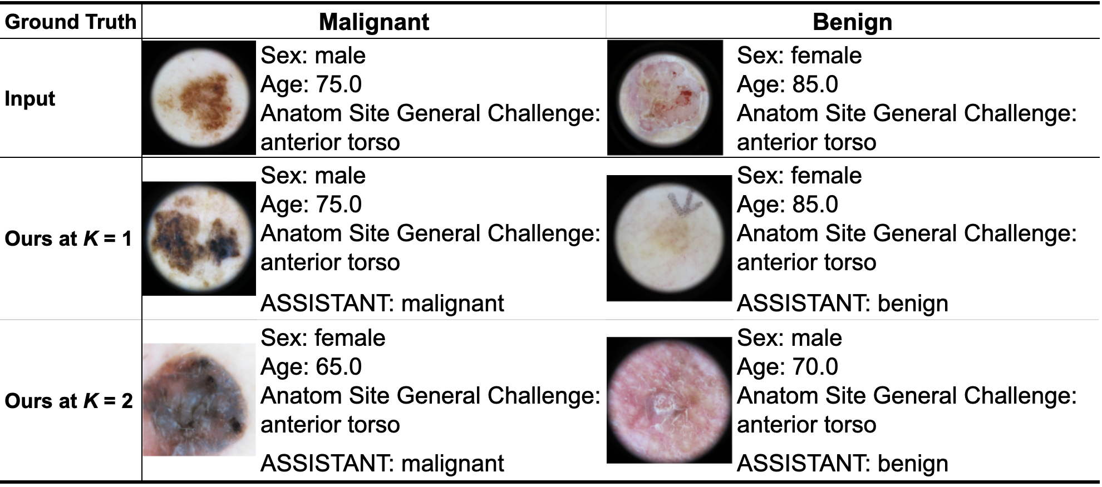
Results
Does RAG improve performance through example-based reasoning without fine-tuning?
Similar lesions with corresponding patient’s metadata
Retrieved
Similar Cases
Fig 2. (a) Misclassified case by all baselines (LLM, early-fusion, zero-shot VLM) correctly classified by our method (K = 2).
Notes:
This brings us to our second research question: Does RAG improve performance through example-based reasoning without fine-tuning?
Our qualitative analysis reveals how retrieved examples contribute to correcting false positives and false negatives that baseline methods fail to resolve.
Here you can see a compelling example where all baseline methods - image-based, text-based, and early-fusion - incorrectly classified the case, but our RAG approach got it right.
What's particularly interesting is how the retrieval works in practice.
Our method retrieves clinically similar examples based on patient characteristics like sex, age, and anatomical site.
The retrieved examples were provided to the VLM as context.
The key insight here is that similar lesions from the same anatomical site provide crucial comparative context.
This mimics how dermatologists naturally reason - they consider not just the lesion itself, but also its location and patient characteristics when making diagnostic decisions.
This example demonstrates how retrieval-based prompting addresses key limitations of VLMs and supports more reliable clinical reasoning without requiring any fine-tuning.

Slide 14
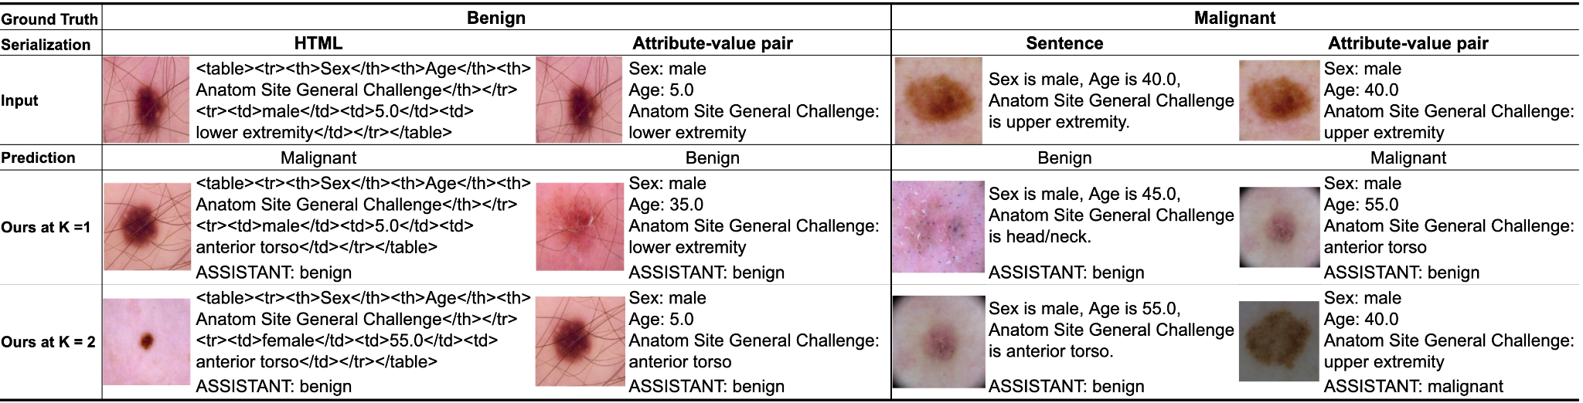
Results
Effect of Input Serialization
Structured metadata encoding enhances VLM's clinical understanding
Notes:
We also investigated the effect of input serialization on our RAG framework's performance.
To evaluate this, we compared three different formats for encoding clinical metadata: HTML, attribute-value pair, and sentence format, all using the same configuration with BERT and ResNeXt-50.
The results show that structured metadata encoding enhances VLM's clinical understanding.
The attribute-value format significantly outperformed the other two approaches in correcting baseline errors.
In the first comparison between HTML and attribute-value pair formats, both methods retrieved similar cases, but there's some difference.
The attribute-value format successfully retrieved an example with the same anatomical site, while HTML format missed this important match.
This single difference in retrieval led HTML to produce an incorrect classification, while attribute-value pair got it right.
Similarly, in the sentence versus attribute-value pair comparison, we see the same pattern.
The attribute-value format again retrieved a case with matching anatomical site that the sentence format failed to capture.
This missing contextual information caused the sentence format to produce an wrong answer.
The key insight here is that attribute-value format encodes clinical variables more explicitly, enabling more precise retrieval of relevant cases.
While other formats preserve the same content, their structure may obscure important clinical features during the retrieval process.
These examples demonstrate that structured input formats, particularly attribute-value pairs, better support retrieval-based reasoning by ensuring critical clinical variables are properly matched.

Slide 15
Conclusion
Proposed a retrieval-augmented VLM framework to improve melanoma classification using retrieved similar cases
Provide example-based explanations via retrieved similar cases
Achieve improved diagnostic performance without fine-tuning
Future work
Extend to multi-class skin lesion classification and other multimodal clinical tasks
Limitations
Depends on curated training data
Retrieval speed needs improvement for real-time use
Notes:
To conclude, we proposed a retrieval-augmented VLM framework that improves melanoma classification by leveraging retrieved similar cases.
This approach addresses the limitations of general-purpose VLMs by incorporating domain-specific knowledge through retrieval rather than fine-tuning.
Our framework provides example-based explanations via retrieved similar cases, making the diagnostic process more interpretable.
Most importantly, we achieved improved diagnostic performance without requiring any fine-tuning, demonstrating the effectiveness of retrieval-augmented generation for medical applications.
Looking ahead, we plan to extend this approach to multi-class skin lesion classification and explore its application to other multimodal clinical tasks beyond dermatology.
However, we acknowledge some limitations.
Our method depends on having well-curated training data for effective retrieval, and the current retrieval speed needs improvement for real-time clinical use.
Despite these limitations, our work demonstrates that retrieval-augmented VLMs offer a promising path forward for developing more interpretable and effective AI diagnostic tools in healthcare.

Slide 16

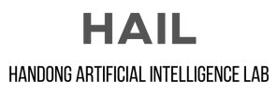
Thank you for your attention
Title
Presenter
Advisor
Retrieval-Augmented VLMs for Multimodal Melanoma Diagnosis
Jihyun Moon (jhmoon@handong.ac.kr)
Charmgil Hong (charmgil@handong.ac.kr)
Notes:
Thank you all for your kind attention.
I am truly grateful to the organizers for giving me this valuable opportunity to present our work today.
I sincerely welcome any questions or feedback you may have.

